Slide 1

Data architecture HARMONIZED LAYER DESIGN & USAGE
Allianz SE
H4-GTA-GDA
Munich, July 21

Slide 2



Consolidating data across the diverse heterogenous data landscape of the Allianz group is no simple task. Apart from the obvious business alignments it requires a smart approach to managing the harmonization of data so the end goal of a single consolidated view is available.
DATA HARMONIZATION
The end objective of the harmonization is the comparative analysis of data across a standardized lens. Harmonization is achieved through the ability to generate and store local to global mappings, to use these mapping in a generic and consistent way to drive reusability and simplification across the whole process. It deals with data at the master, reference, transactional and KPI levels.

Slide 3
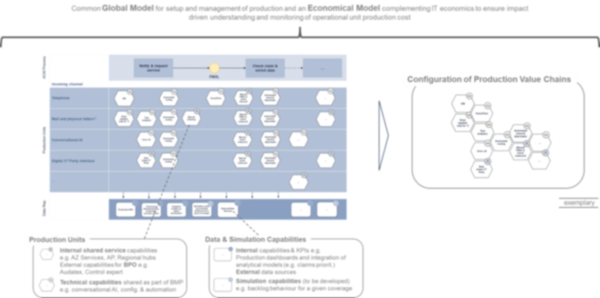
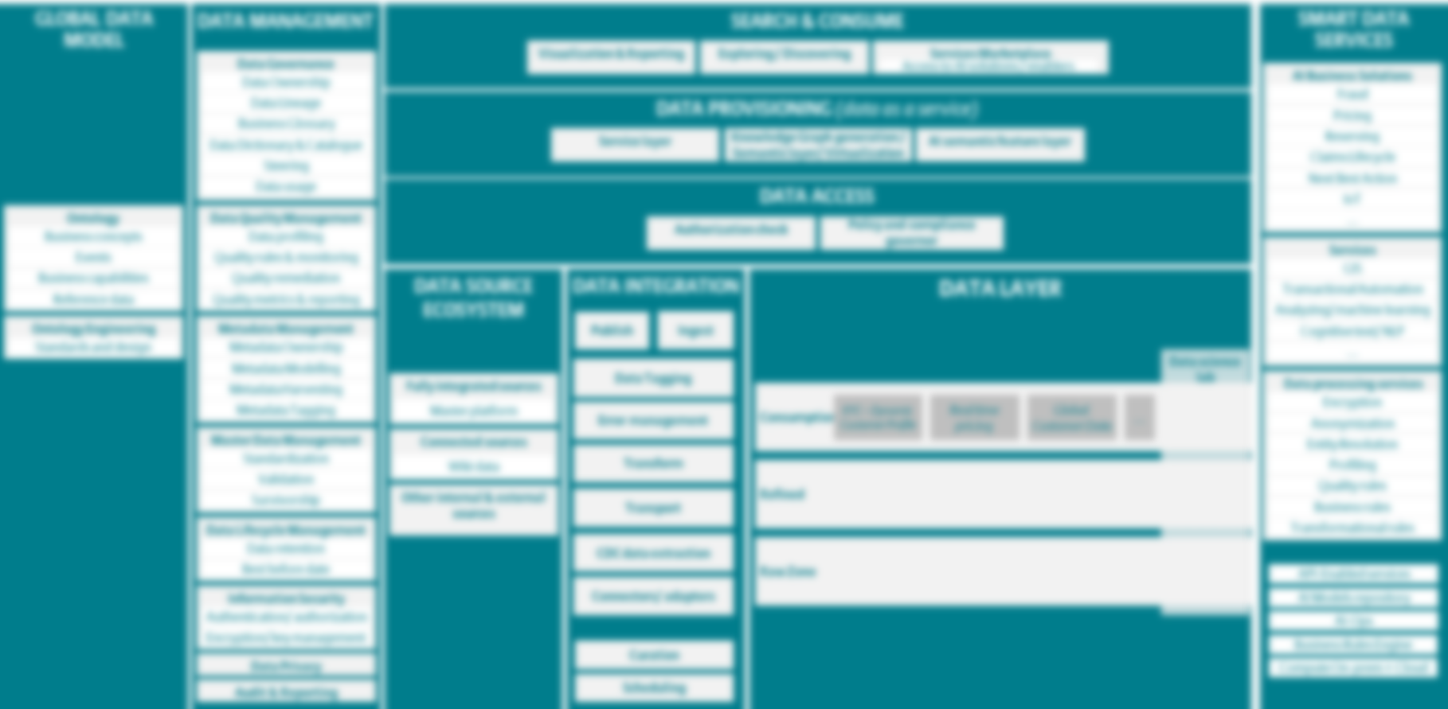
global data harmonization @ 4 levels driven by harmonization on business level
Business needs / usages
Standardization of Business capabilities, business processes / production units / activities and underlying data flows and data, as well as standard way of data consumption (ACM processes, ACM Claims MIS, ALEx, standard AI models, etc.) are key for data harmonization
Global Business Glossary (GBG)
Enterprise Ontology / Global Business Model
Harmonized Data Layer
Global Business Glossary is a meta data repository that contains globally harmonized data terms and definitions, standard KPIs, and standard reference data values
GBG is approved by Global Data Fitness Council, with representatives of all global functions
GBG is Published quarterly, it currently contains key data for global use (ALEx, DataFy, Aspire etc.)
OEs are participating in the working groups organized by business functions, and through the Data Governance Advisory Board
Enterprise Ontology or Global data Model is a meta data model that represents the business model, and in addition to data contains the relationships between them (contract/customer, claims event/claim etc)
GDM contains all data approved and published in GBG
Real Data from the OEs is onboarded to the Global data Platform (GDP), harmonized across OEs and data sources and stored in the harmonized data layer for further consumption
ACM Claims MIS example: data is coming from 5 OEs, and 3 types of data sources, insurance, survey and telephony
Data is harmonized with the help of Global Business Glossary (common definitions) and Enterprise Data Catalog (EDC) that contains local to global metadata mapping. EDC is connected with Global Business Glossary to ensure globally harmonized definitions
Once in Harmonized Data Layer, data can be consumed for multiple use cases

Slide 4
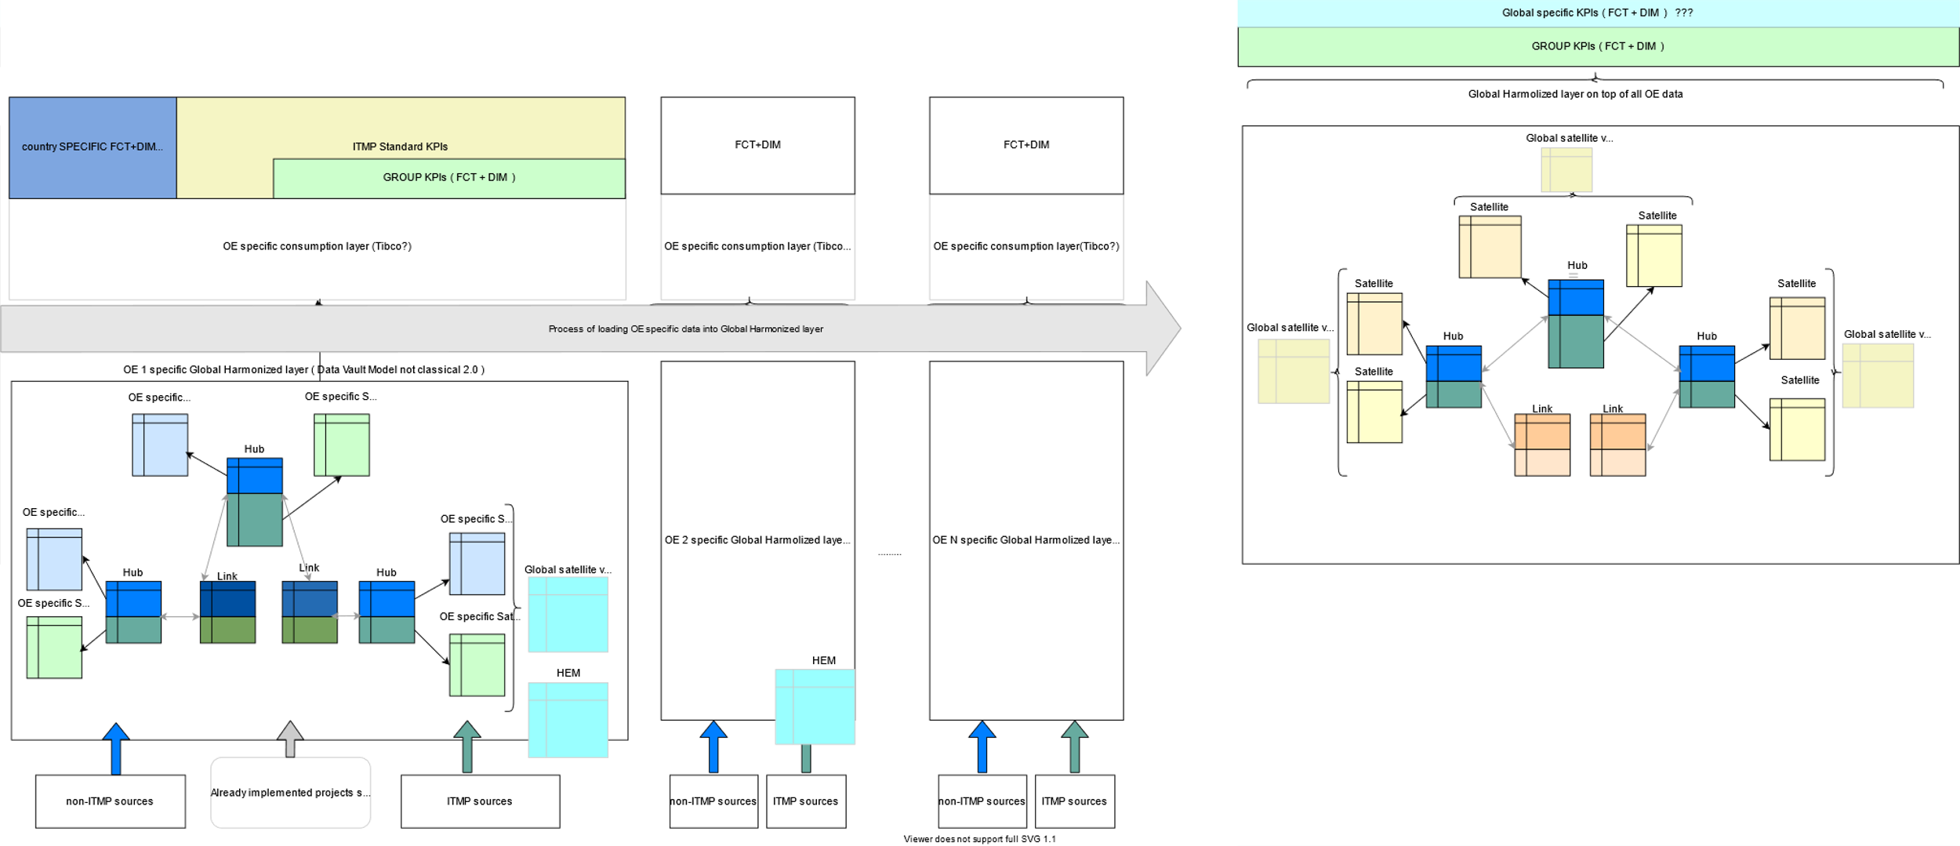
Overview
List of topics
Local Harmonized Layer
OE Level Harmonization
OE Level Consumption
OE Level Ingestion
Global Harmonized Layer
Global level Harmonization
Global level Ingestion
Harmonized Layer vs Data Vault 2.0
Model Governance
Application to existing projects
Q&A
Illustration to be adjusted

Slide 5
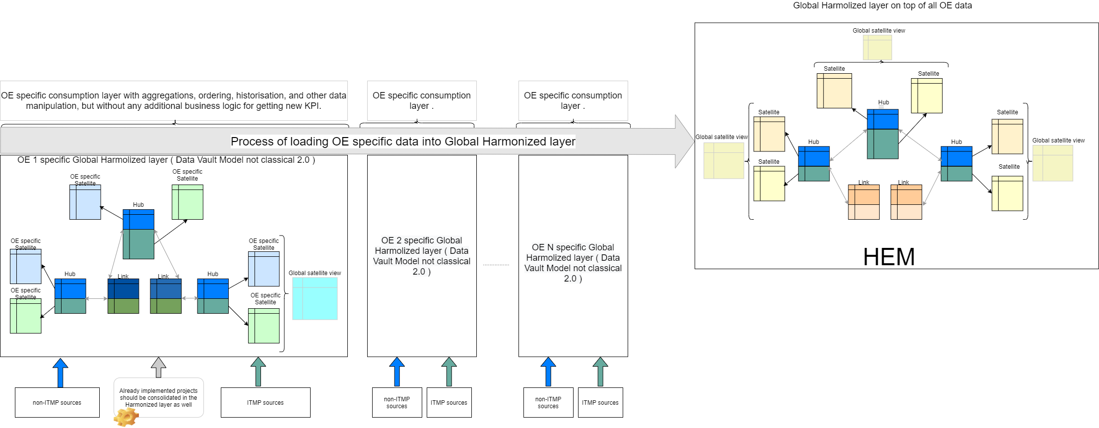
LOCAL Harmonized LAYER OE LEVEL HARMONIZATION
Aligned Design principles
Each OE implementation of GDP should have one Harmonized layer which will consolidate all sources (ITMP & non ITMP) of information.
Local Hubs & links are a superset of the Global Hub & Link model.
The Global Hub & link model is centrally owned (syn = defined) & rollout out to all instances of GDP
Satellites can be implementation-specific eg by source, by type (GDPR relevant).
Outstanding points / candidates
How do we create view of an attribute accross all satellites
Virtual global satellite view should be created in the harmonized layer.
Define/specify « Harmonized data» eg
Linked to Governance re: definitions
Mapped to ref Data
Unique business keys
…
Historization concept : eg depending on business needs
Load timestamp for technical validity (gdp_load_ts)
In case of effectivity part of the key (mainly in satellites and weak links)
Optional:
Business validity (Biz_eff_from & Biz_eff_to)
Source system validity
Illustration to be adjusted

Slide 6
LOCAL Harmonized LAYER OE LEVEL CONSUMPTION
Aligned Design principles
To be developped
Outstanding points / candidates
Rows prioritization, aggregation, historization could be done in the consumption layer. But we should avoid business logic there and especially new KPI creation which aren’t exists in the harmonized layer ( way back should be provided then ) .
Illustration to be adjusted

Slide 7
LOCAL Harmonized LAYER OE LEVEL INGESTION
Aligned Design principles
To be developped
Outstanding points / candidates
Data from ITMP systems (ABS, One Marketing,…) is ingested through ….
Data from non-ITMP sources is ingested through Common Ingestion Model (CIM)
Illustration to be adjusted

Slide 8
GLOBAL HARMONIZED LAYER GLOBAL LEVEL HARMONIZATION
Aligned Design principles
The subset of data relevant for global use cases will be loaded into the Global Harmonized Layer from all OEs.
Global Hubs & links are a subset of the Local Hub & Link model.
Outstanding points / candidates
Detail approach for federating the Data
Illustration to be adjusted

Slide 9
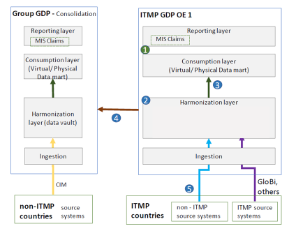
GLOBAL HARMONIZED LAYER GLOBAL LEVEL INGESTION
Aligned Design principles
To be developped
Outstanding points / candidates
To be developped
Illustration to be adjusted

Slide 10
HARMONIZED LAYER VS DATA VAULT 2.0 SIMILARITIES & DIFFERENCES
Data Vault 2.0 specification | Allianz Harmonized Layer design
Can easily adapt to changing (agile) environments by allowing for new data sources to be added without impacting the existing design → no need for reengineering Supports large sets of data
Consisting of the three main entities: Hubs, Links and Satellites
Keys generated using hash key logic | Using md5-function to generate keys
2 steps data harmonization process, first through « raw Vault » & then into « Business Vault » | Harmonization performed : a. during ingestion process eg column name alignment, data type, transformations/concatenation of fields. b. Within Harmonization Layer : summary satellites ? c. Reference data ?
…

Slide 11
MODEL GOVERNANCE
Aligned Design principles
Global Business Glossary (GBG)
Aligned definitions of all business terms and data attributes that are critical for Allianz’s business.
Enterprise Ontology (EON)
Adds relationships to the glossary and shapes it into a human and machine-readable model using sematic technologies and linked data.
Global Harmonized Layer Model (GHLM)
Master model of controlled and governed Hubs & links.
Satellites created only for data relevant in Global Data Initiatives;
Common Ingestion Model (CIM)
Interface definition for global projects aligned with Ontology and Global Business Glossary. Main goal of CIM is to create global view over all business entities available within a Global Business Glossary and Ontology, describe relationships between business entities and establish single, harmonized source of true.
Local Harmonized Layer Model (LHLM)
Hubs & links owned centrally and derived from GHLM.
Satellites “owned” by OE with some potential exceptions (eg Party & entity location)
Outstanding points / candidates
Global Data Initiatives
Global Business Glossary
sync
Enterprise Ontology
Global Data Fitness Council /H4
Drives
GHLM
H4 / AZ Tech
+
Project owners
CIM
Hub structure
OE Data needs
LHLM
OE‘s

Slide 12
Implications for running projets
Already implemented flows should be consolidated in the harmonized layer as well.
Gaps to stated principles (eg project specific links, missing ‘consolidated’ satellite, ….) should be analyzed and might imply efforts for adjustment .
MIS Claims - Gap analysis
To be developped
GDW@GDP - Gap analysis
To be developped
…. - Gap analysis
To be developped

Slide 13
OPEN QUESTIONS
David’s Grouping | No. | Topic | Question | Answer
1 | 7 | Global data vault model (HEM) vs local data vault model GDW@GDP | The HEM has its own data vault model. The GDW@GDP project is building a separated data vault model: There is any use case you see at the moment of in the future where the 2 models have to coverge? Do they have to converge? If yes, how? Does the convergenge is happening only at Business Global Glossary /Metadata server level?
 | 8 | Global data vault model (HEM) vs local data vault model GDW@GDP | How HEM and data vault model GDW@GDP fit together?
2 | 2 | Data vault modeling | Please specify if there is a raw data vault concept and if yes, its purpose.
 | 3 | Data vault modeling | What is the connection between the raw data vault and the harmonization layer ?
 | 4 | Data vault modeling | Is there any business vault concept within the harmonization layer?
 | 5 | Data vault modelling GDW@GDP | The naming of hubs and links in the data vault for GDW@GDP is so that those match to the existing GDP hubs and links. Satellites names are then source system-specific.
 |  |  | Does the unification of the data from different sources will be on top, into a common Data Vault?. Does this common Data Vault exist or is it just a concept?
 | 6 | Data vault modelling GDW@GDP | UC1: As satellites are split by source systems => ABS data in own satellites. Legacy data has to be ingested also. Do this system will have own satelites? Where is satellite data from multiple sources combined?
 | 1 | Data vault modeling | Is target architecture compliant with the Data Vault 2.0 architecture as defined by the Data Vault Alliance?

Slide 14
BACKUP

Slide 15
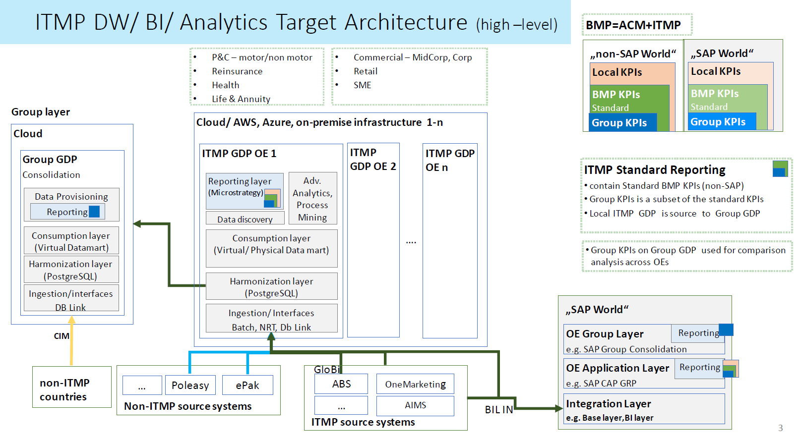
to be adjusted

Slide 16
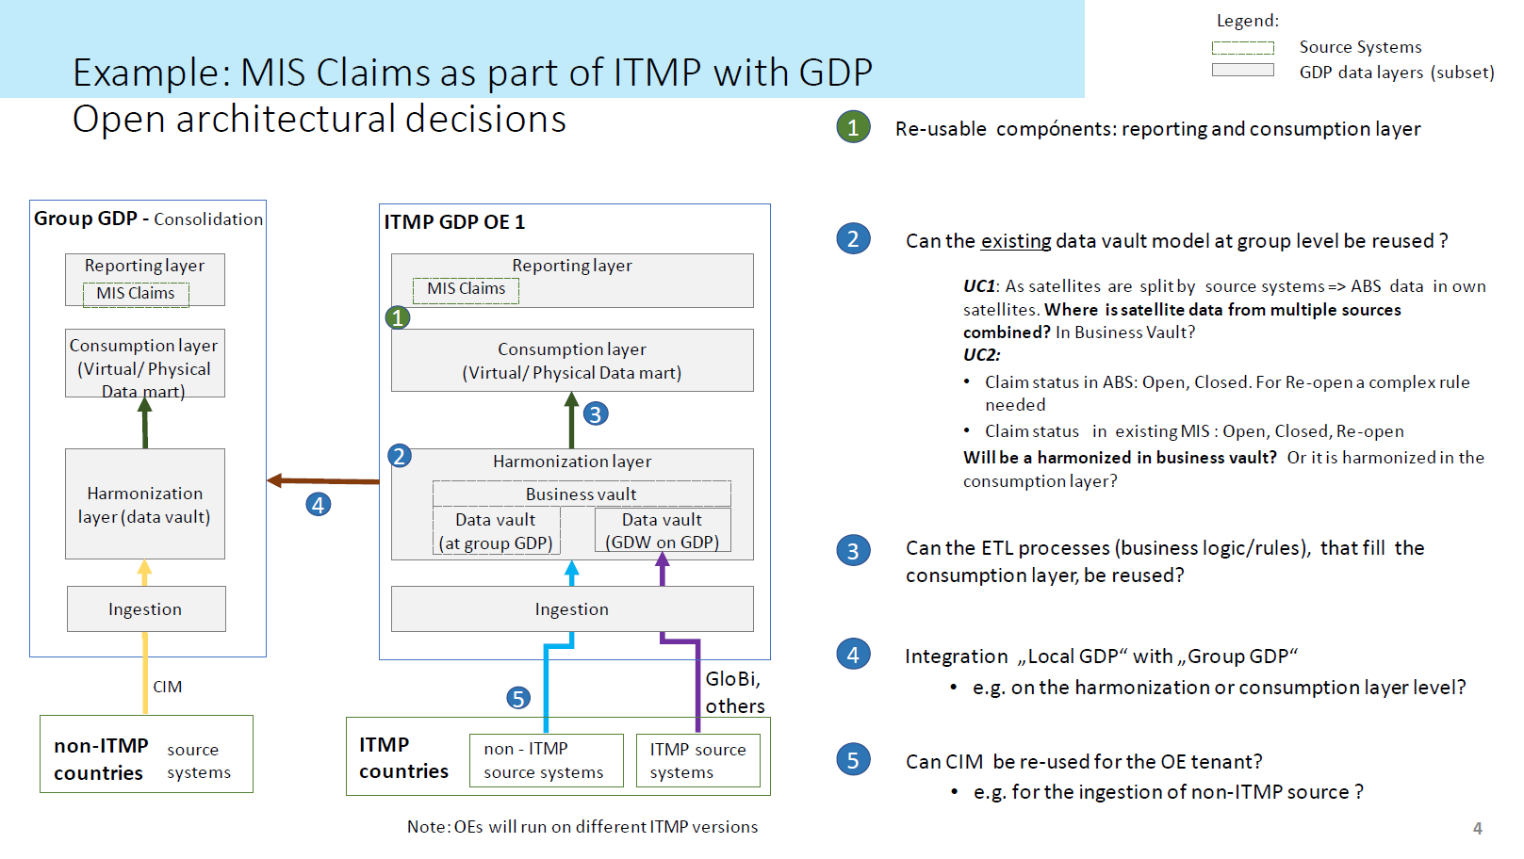
to be adjusted

Slide 17
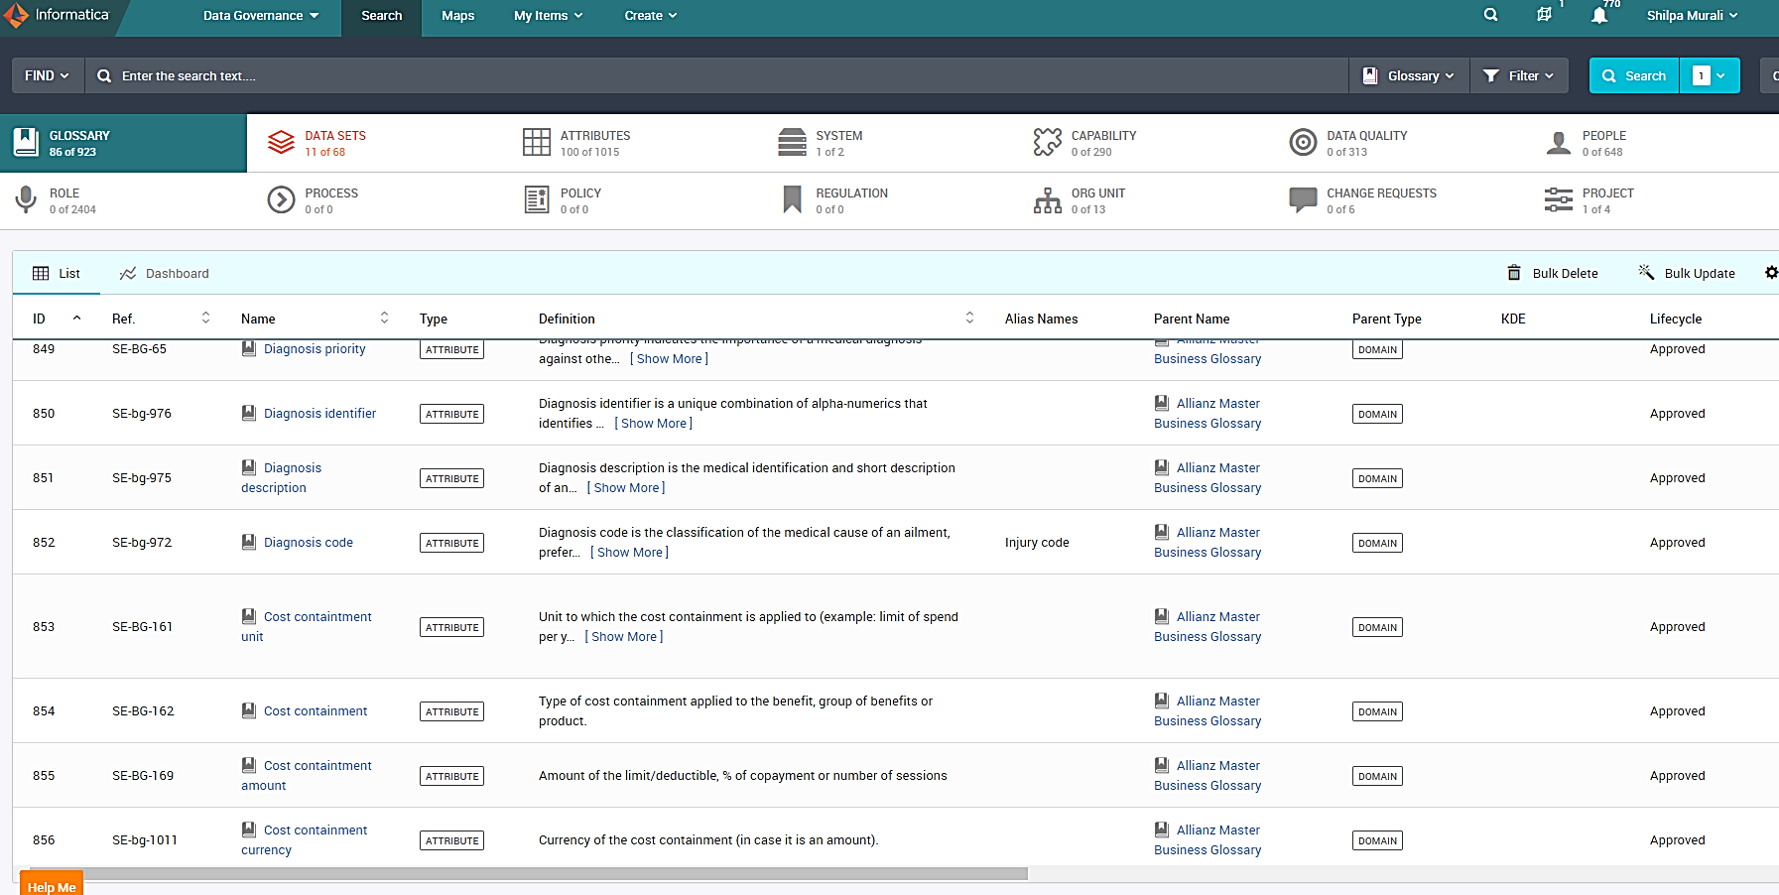
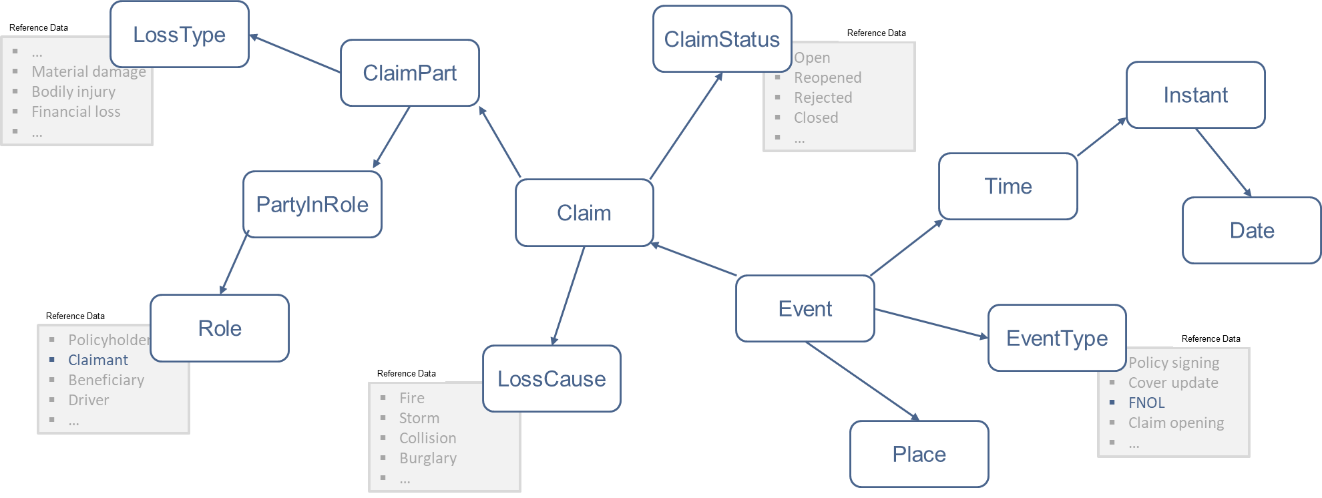
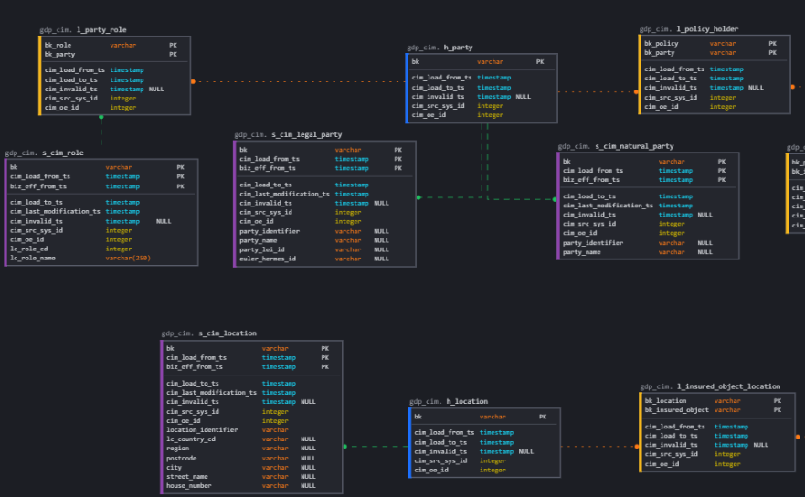
global data harmonization established at 4 levels driven by business needs
to be adjusted
ITMP
Business Glossary
Ontology
Common Ingestion Model
ITMP Data warehouse model
Aligned definitions of all business terms and data attributes that are critical for Allianz’s business.
GBG is Published quarterly, it currently contains key data for global use (ALEx, DataFy, Aspire etc.) in the data governance tool
All entities need to adopt the Global Business Glossary
GBG is approved by Global Data Fitness Council, with representatives of all global functions
OEs are participating in the working groups organized by business functions, and through the Data Governance Advisory Board
Adds relationships to the glossary and shapes it into a human and machine-readable model using sematic technologies and linked data.
Ontologies consists of
Concepts*)
Relationships between concepts
Attributes
Help to move from simple business term definition to business question formulation
Provides harmonized data collection across use cases and high level of standardization.
Data vault concept consisting hubs, links and satellites
Uses ontology as a basis to define the respective satellites and hubs.
Iteratively updated based on global use cases and signed off by OEs
Core model used for local reporting, supporting daily reporting and ad-hoc analysis of insurance data coming from ABS/ITMP.
Mapped to the glossary to have an end to end lineage from business terms to technical metadata.
What are the key data points for my use case?
How do the data points relate to each other?
How is the data collected from the different systems?
Where is the data in my “core insurance platform?“

Slide 18



HARMONIZATION PROCESS FOR DATA STACK ACROSS GROUP & OEs
to be adjusted
GLOBAL INITIATIVES
Claims MIS
Commercial P&C
Simplifi.....
OE requests
Existing data models(ITMP)
Business Glossary
Data office informs the OE sounding board and the Global data fitness Council regarding timeline and scope of harmonization
OE sounding board validating
and harmonizing the data scope.
OEs are rotated within the sounding board based on the use cases being discussed
Further validating input and refining global definitions across group functions to have one harmonized vocabulary for the data scope,
Data office updates all working groups with the final validated definitions for review
Global data fitness council as formal body to sign off on all definitions
Terms approved
Owners assigned
Reference data harmonized
Group Data office
Data fitness Council
GP&C /H10 /Life/ Health /Finance/ Allianz Re/GSMD
Group Data office
Current OEs involved : AGCS/Italy/
/ Germany/ Brazil/ UK
Affected applications - APL
Data fitness working group:
GP&C /H10 /Life/ Health /Finance/ Allianz Re/GSMD
Ontology approved & published
Ontology
Ontological model for the selected scope being
built
Discussions between affected owners at
Group level on the model relationships
Data office creates Ontology URIs and patterns
And sends the validated model for review
Global data fitness council as formal body to sign off on the business data model
Group Data office
Data fitness working group:
GP&C /H10 /Life/ Health /Finance/ Allianz Re/GSMD
Group Data office
Data fitness Council
GP&C /H10 /Life/ Health /Finance/ Allianz Re/GSMD
CIM approved & published
Common Ingestion Model
Common ingestion model for the selected scope based on Business & technical models
(Ontology & ABS)
Discussions between affected stakeholders to build the model
CIM workshops conducted with OEs and use case owners to validate the model
Sign of from respective use case owner and relevant OEs
Group Data office + AZ Tech
+ OE & SE business experts
Group Data office + AZ Tech
+ OE & SE business experts
OE & SE business experts
Group Data office + AZ Tech

Slide 19
Harmonising Data for Global Solutions OVERVIEW OF DESIGN PRINCIPLES
to be adjusted
4
2
Data source ecosystem
Data Layer
Global Business Glossary (GBG)
Enterprise Ontology / Global Business Model
OE 1
1
Consumption
Claim_nb: number
ClaimID:
Status:
Amount:
Status: Open, Close
Amount: USD
OE 2
Harmonized /Refined
3
ClaimID:
Status: open,close
Amount: Euro
Claim_ID: alpha-num
Status: 0, 1
Amount: Euro
OE 3
Claim_nb: 231344
Status: Open,
Amount: 300 USD
ID: String
Claim_ID: ACXD3
Status: 0
Amount: 200 Euro
Status: Open, Run, Close
ID: Claim300
Status: Run
Amount: 132 Euro
Amount: Euro
BMP / ITMP
5
Data
Integration
Capabilities
Common Ingestion Model
Virtualization
Data Ingestion Pipelines
…
Others / External…
1
Each use case (Smart MIS, Standard Reporting) relies on a specific consumption oriented model/mart, on which dedicated UI’s can be built.
Required data comes from heterogenous sources : OE Legacies, BMP / ITMP, External sources, etc.
Data supporting all use cases is made accessible in the “Harmonized Layer”, following a single model, supporting multiple use cases. Data feeding into GDW reports is also part of HL. Data in HL follows a unique schema mapped to global glossary, reference values are mapped to global values allowing for comparison across OE’s.
All Data models are linked to Global Business Glossary and Enterprise Ontology, at least for globally relevant data. All models are instantiations of subsets of EO.
Different mechanisms are available for onboarding data and populating HL. In particular, CIM & Virtualization are relevant for OE legacies : by delivering data following the unique CIM schema, OE’s will cover multiple data requests with a single delivery.
2
3
4
5

Slide 20
Harmonising Data for Global Solutions TaSKS FOR EXTENDING TO NEW USE CASES
to be adjusted
7
Data source ecosystem
Data Layer
Global Business Glossary (GBG)
Enterprise Ontology / Global Business Model
OE 1
Consumption
Claim_nb: number
ClaimID:
Status:
Amount:
1
Status: Open, Close
2
Amount: USD
OE 2
Harmonized /Refined
ClaimID:
Status: open,close
Amount: Euro
6
Claim_ID: alpha-num
Status: 0, 1
Amount: Euro
OE 3
Claim_nb: 231344
Status: Open,
Amount: 300 USD
3
ID: String
Claim_ID: ACXD3
Status: 0
Amount: 200 Euro
Status: Open, Run, Close
ID: Claim300
Status: Run
Amount: 132 Euro
Amount: Euro
BMP / ITMP
5
Data
Integration
Capabilities
5
Common Ingestion Model
Virtualization
Data Ingestion Pipelines
…
4
Others / External…
1
Define data scope for consumption based on project/business requirements (if required, extend GBG for attributes & reference values).
Decide to re-use existing data mart or build a new one / Implement consumption mart.
Reuse data from Harmonized Layer, extend model based on Enterprise Ontology in case of any new data / requirements.
Extend CIM with any new data / requirements, based on Enterprise Ontology.
Extract and onboard Data from sources, map local metadata to global metadata within EDC
Data in HL is checked for quality and remediated if possible
Build UI‘s
BO+PO+AZTE+GDFC
GDA+AZTE / PO+AZTE
AZTM+GDA
AZTM+GDA+BO
DOT+OE
AZTE+BO+PO
BO+AZTE
2
3
4
5
6
7
Legend: BO – Business Owner, PO – Project Owner, AZTE – AZ Tech Engineer, GDA – H4-GTA-GDA, AZTM – AZ Tech Modeler, DOT – Data Onboarding Team

Slide 21

AS-IS PROCESS FOR CLAIMs MIS
to be adjusted
AZ Tech/Project Team
H4-GDA
Consuming CIM via KAFKA pipeline (data are within a topics)
Conceptual Data Model: Ontology Model
AZ Tech/Project Team
Harmonized Layer (Data are persisted)
Subsets in
Configure connectors and sync connectors Create KSQL queries
H4-GDA
H4-GDA
Consumption Layer (Standard conformed Dims & Facts being customized subset of data from Harmonization Layer)
Common Ingestion Model
Defining schema
OE
AZ Tech/Project Team
OE
Details in
OE
Data Virtualization (local instance)
Physical Data Model:
Physical CIM Model
Delivering data within CIM format
Applying technical DQ checks to make pipeline “RUN”
TIBCO
OE
Semantic Consumption Layer (Virtual Data Sets & Marts)
Flat Files
Raw Layer (Azure File System)
e.g. CSV
OE
Persisting data into Raw Layer

Slide 22
Responsibilities in the data architecture
to be adjusted
Responsibility for the conceptual artefacts belongs to H4-GDA.
Instancing the data in the CIM format is an OE responsibility.
Data Architecture
Delivery
H4-GDA
H4-GDA
H4-GDA
Capability (based) Architecture
Business Objects
Composes in
Conceptual Data Model: Ontology Model
Allianz Ontology Model
Subsets in
H4-GDA
H4-GDA
Functional Architecture
Common Ingestion Model
SQL CIM Model
OE
OE
Details in
OE
Physical/Technical
Architecture
Data Objects
System specific
Composes in
Physical Data Model:
Physical CIM Model
Data in CIM format
OE
Responsibility

